Slide 1



Energy Efficiency in Smart Buildings
College: Symbiosis Institute Of Technology, Nagpur
Names: Palak Bedi (22070521004)
Manya Asrani (22070521042)
Alankrita Bhonde (22070521061)

Slide 2
Problem Statement : Energy Efficiency in Smart Buildings
Brief Overview:
Buildings account for nearly 40% of global energy consumption.
Enhancing energy efficiency is vital to achieve sustainability goals.
Commercial buildings with high energy usage are a primary focus.
AI-powered systems can:
Analyze energy consumption patterns.
Optimize heating and cooling systems.
Provide actionable recommendations to reduce energy usage.
Key Objectives:
Reduce overall energy consumption in buildings, especially commercial ones.
Analyze energy usage patterns to identify inefficiencies.
Support sustainability goals by addressing significant energy demands.

Slide 3
Dataset Overview
Size: 100 records with 7 key features.
Key Features:
Building Type: Indicates the category (Residential, Commercial, etc.).
Square Footage: Total area of the building.
Number of Occupants: Total individuals in the building.
Appliances Used: Number of appliances in use.
Average Temperature: Average temperature for the time period.
Day of Week: Indicates whether the data is for a weekday or weekend.
Energy Consumption: Total energy used (measured in relevant units).
Purpose: The dataset can be used for analyzing energy consumption patterns based on building characteristics, environmental factors, and occupancy behavior.

Slide 4
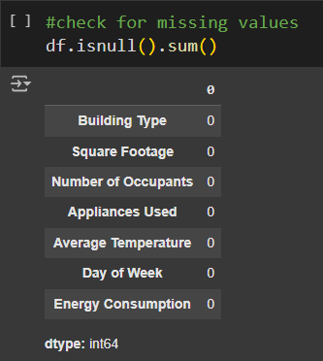
Methodology
Approach
Step 1 : Data Preprocessing
Missing Data:
Checked for missing values using df.isnull().sum().
No significant missing values found.
2. Data Summary:
Used df.describe() for statistical insights.
3. Feature Identification:
Independent Variable: Square Footage
Target Variable: Energy Consumption.

Slide 5
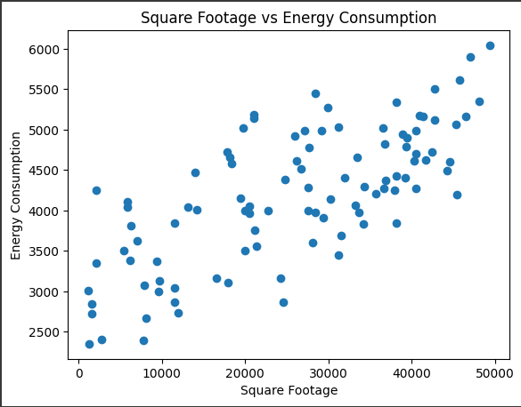
Methodology
Approach
Step 2 : Exploratory Data Analysis
Scatter Plot Analysis:
Created a scatter plot of Appliances Used vs Energy Consumption.
Observed a linear trend between the two variables.
Insights:
As the number of appliances increases, energy consumption also increases linearly.

Slide 6
Methodology
Approach
Step 3 : Model Selection
Algorithm Chosen: Linear Regression
Reason for Selection: Linear regression is simple, interpretable, and suitable for continuous target prediction.
Assumptions: Linearity between Square Footage and Energy Consumption.

Slide 7
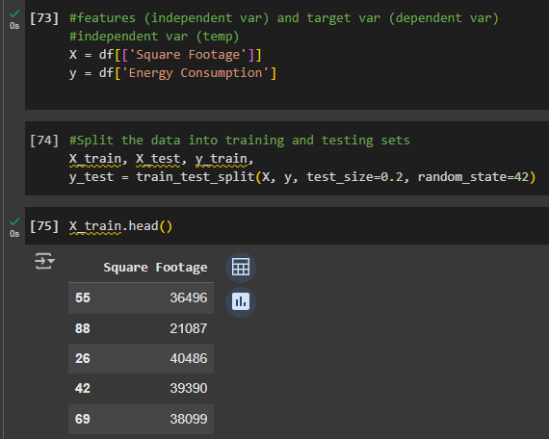
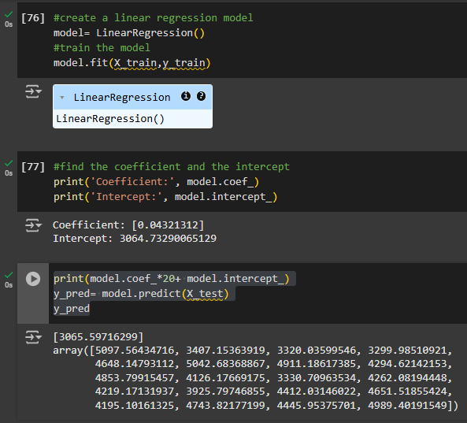
Methodology
Approach
Step 4 : Model Implementation
Platform Used: Google Colab
Steps Taken:
Imported libraries: pandas, numpy, matplotlib, and sklearn.
Loaded dataset using pd.read_csv().
Split data into training and testing sets using train_test_split() (80% train, 20% test).
Trained a Linear Regression model using LinearRegression() from sklearn.
Predicted Energy Consumption on the test set.

Slide 8
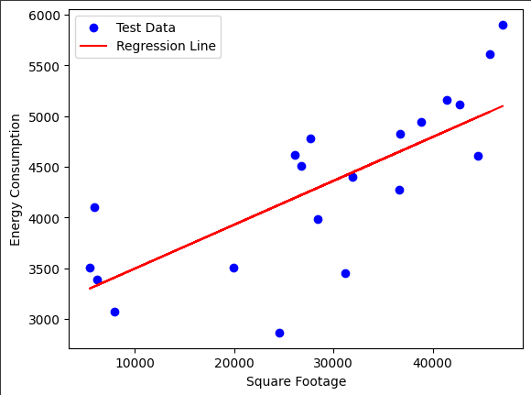
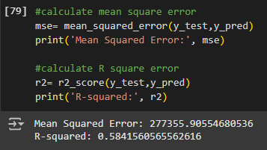
Methodology
Approach
Step 5 : Model Evaluation
Metrics Used:
Mean Squared Error (MSE): 277355.90554680536
R² Score: 0.5841560565562616

Slide 9
Conclusion: Enhance energy efficiency in buildings using AI systems to analyze and optimize energy consumption.
Solution:
Analyzed energy data for residential and commercial buildings.
Identified key factors: building type, occupancy, appliances, and temperature.
Used Linear Regression to predict and optimize energy usage.
Effectiveness:
Reduced energy waste and improved sustainability metrics.
Enabled data-driven decisions, saving costs and reducing carbon footprints.
Future Work
Data Integration: Real-time IoT data and expanded datasets.
Modeling: Advanced AI models and self-learning algorithms.
Scalability: Broaden to smaller buildings and modular solutions.

Slide 10
References
https://colab.research.google.com/drive/1HxPLZe3TcnDbPKX0dOtSDHe_uPowS3QT
https://www.kaggle.com/datasets/govindaramsriram/energy-consumption-dataset-linear-regression

Slide 11
Thank You
Notes:
Thank You !!

